Slide 1

Mode shapes of Sk$\ddot{o}$ll with flexible wings WS2
Virginia Tech
Aug 28, 2015

Slide 2
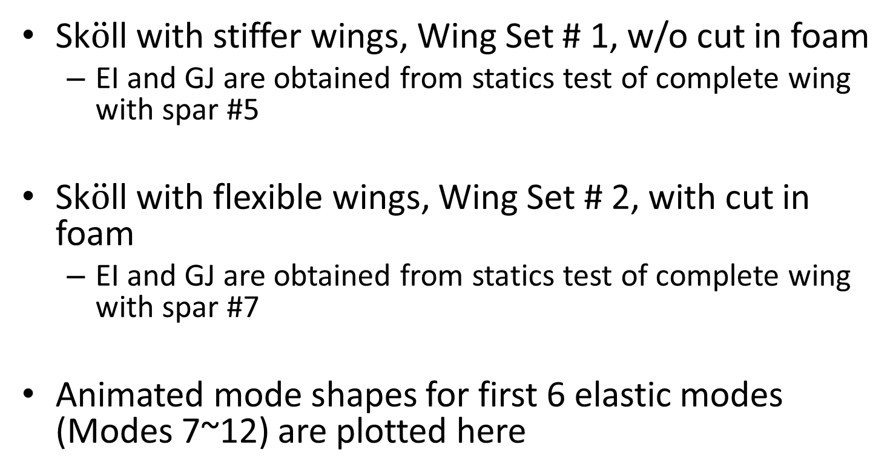
Sk$\ddot{o}$ll with stiffer wings, Wing Set # 1, w/o cut in foam
EI and GJ are obtained from statics test of complete wing with spar #5
Sk$\ddot{o}$ll with flexible wings, Wing Set # 2, with cut in foam
EI and GJ are obtained from statics test of complete wing with spar #7
Animated mode shapes for first 6 elastic modes (Modes 7~12) are plotted here

Slide 3

WS1
Sk$\ddot{o}$ll with stiffer wings

Slide 4
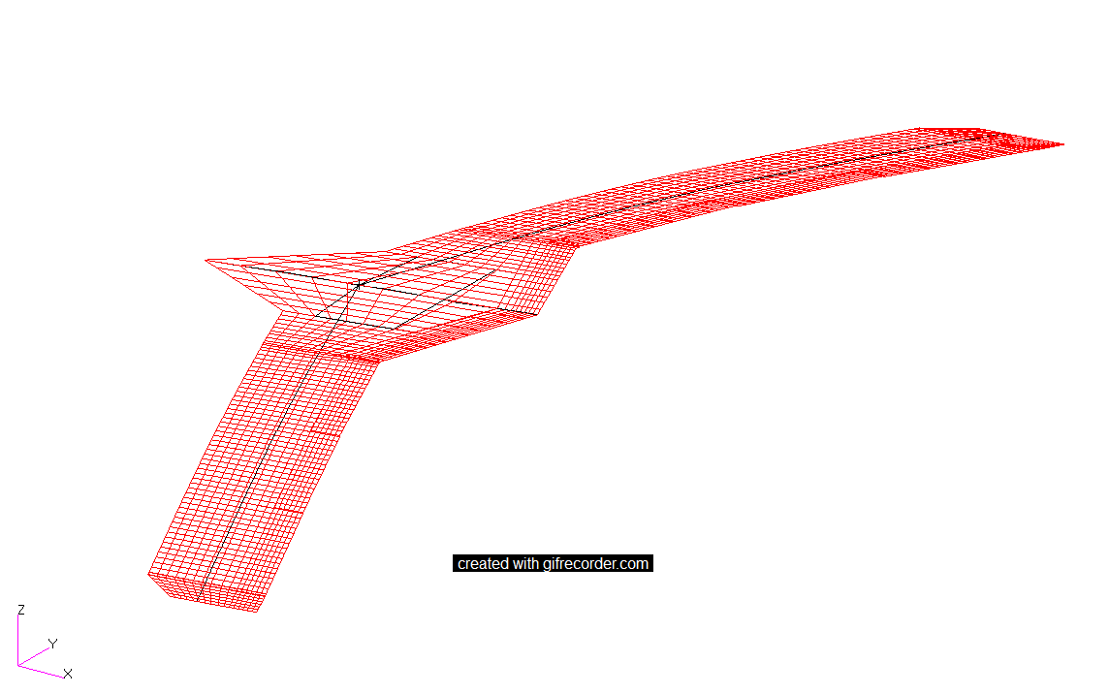
Mode 7
1st Symmetric bending mode
6.63 Hz

Slide 5
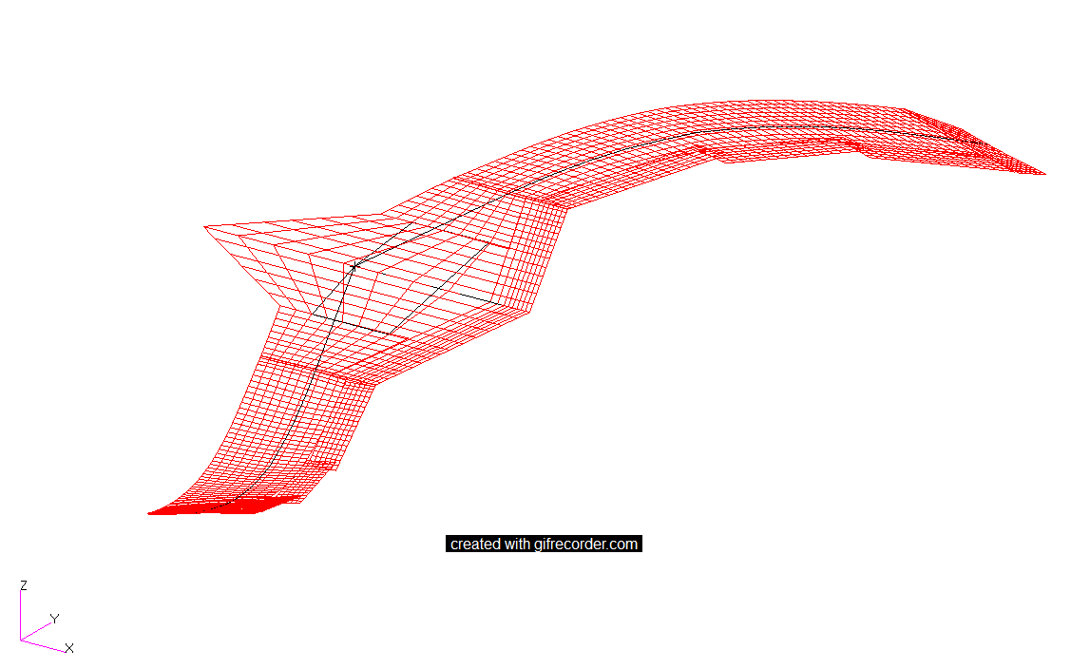
Mode 8
1st Anti-Symmetric bending mode
9.33 Hz

Slide 6
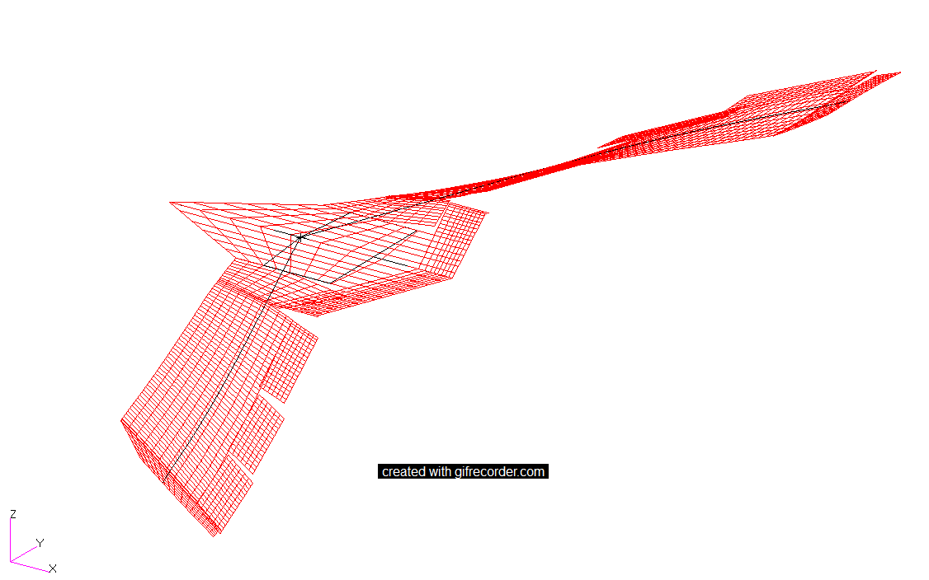
Mode 9
1st Anti-Symmetric torsion mode
14.25 Hz

Slide 7
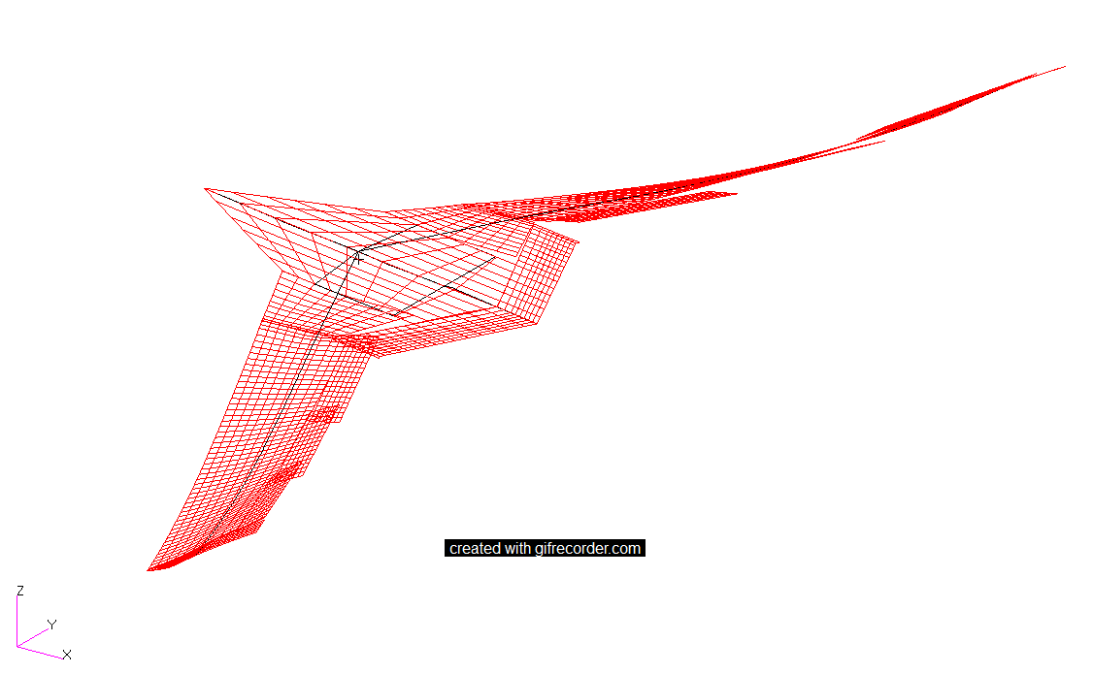
Mode 10
1st Symmetric torsion mode
15.66 Hz

Slide 8
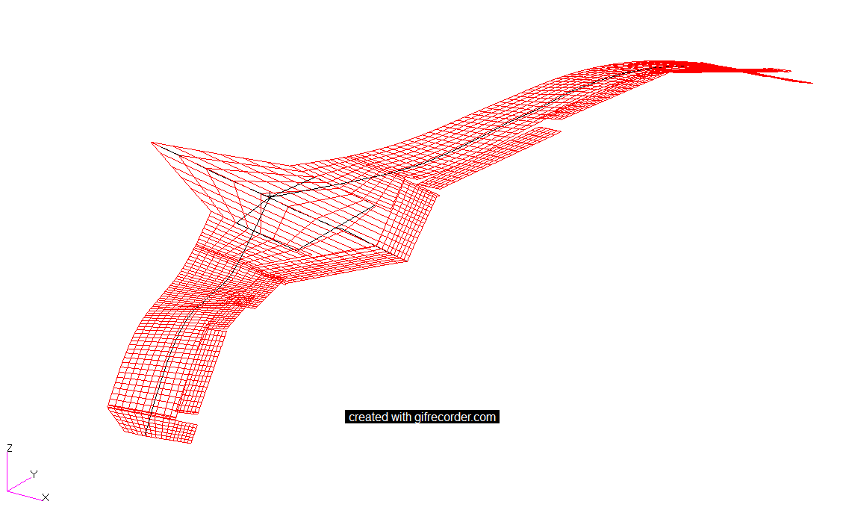
Mode 11
2nd Symmetric bending mode
19.97 Hz

Slide 9
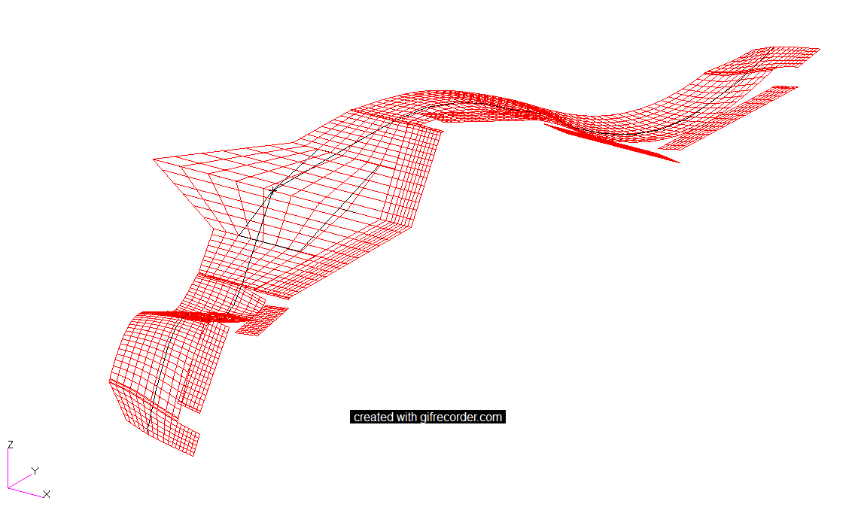
Mode 12
2nd Anti-Symmetric bending mode
24.13 Hz

Slide 10

WS2
Sk$\ddot{o}$ll with flexible wings

Slide 11
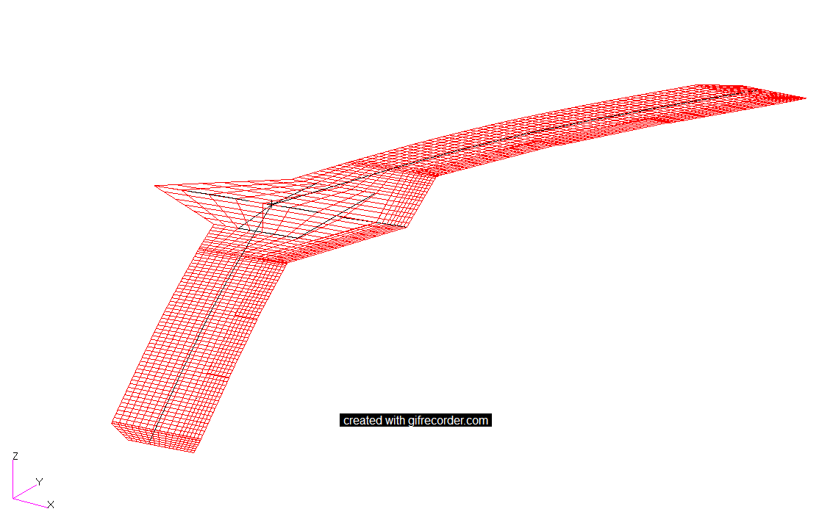
Mode 7
1st Symmetric bending mode
4.76 Hz

Slide 12
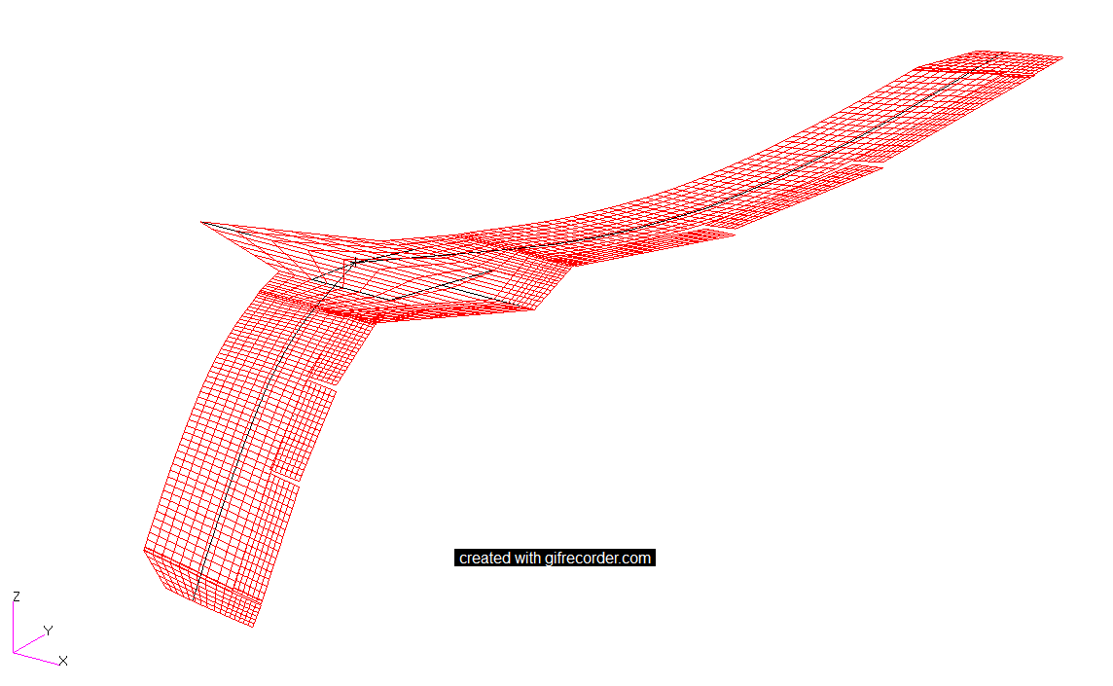
Mode 8
1st Anti-Symmetric bending mode
6.68 Hz

Slide 13
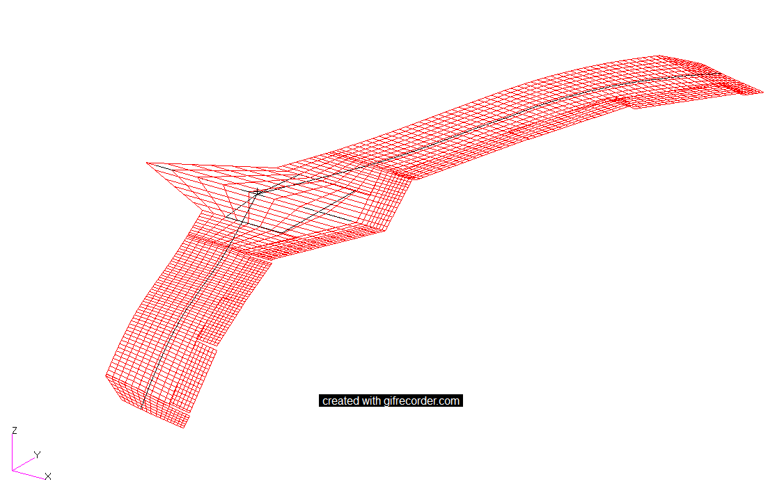
Mode 9
2nd Symmetric bending mode
13.60 Hz

Slide 14
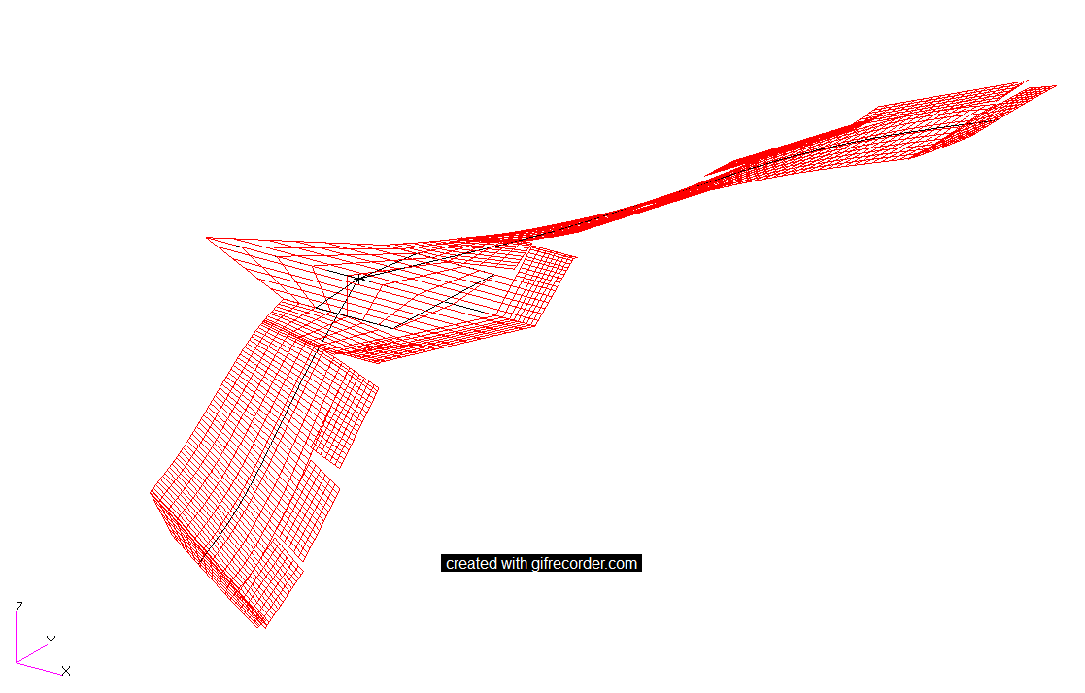
Mode 10
1st Anti-Symmetric torsion mode dominated
14.39 Hz

Slide 15
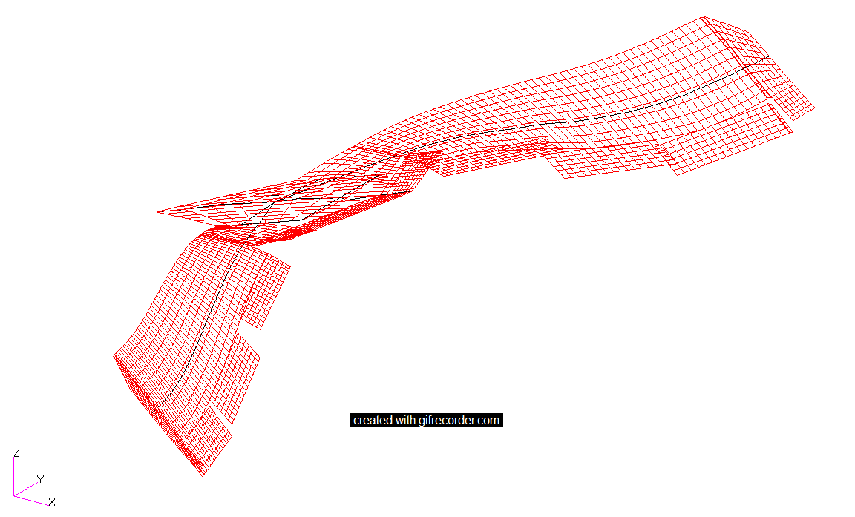
Mode 11
1st Symmetric torsion mode dominated
16.70 Hz

Slide 16
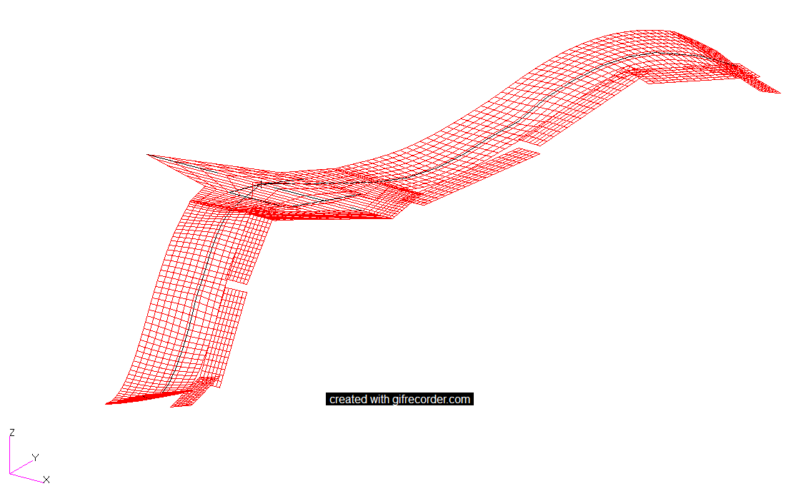
Mode 12
2nd Anti-Symmetric bending mode
17.37 Hz

